Slide 1
Vertent™
Design Story

Slide 2
Vertent™ Design Story
Where It Began
The Vertent project started with a simple observation.
The goal was never to create another insulated bottle. It was to create
an affordable, reusable alternative that could fit nat urally into the convenience store experience while reducing single-use plastic waste.
Like many people, I enjoy stopping at convenience stores such as QuikTrip for fountain drinks. Every visit ended the same way: another disposable cup. Some cups were reused briefly, many collected in kitchen cabinets, and countless others eventually ended up in landfills or as litter.
I imagined a system where customers could return with their own Vertent cup and pay only for the beverage instead of purchasing another disposable container.
The concept could work with convenience stores, restaurants, and quick-service chains by rewarding reuse instead of waste.
The question became simple:
Could a reusable cup be designed that people would actually want to bring back?
This became the foundation of what would later become the Service Series.
1

Slide 3
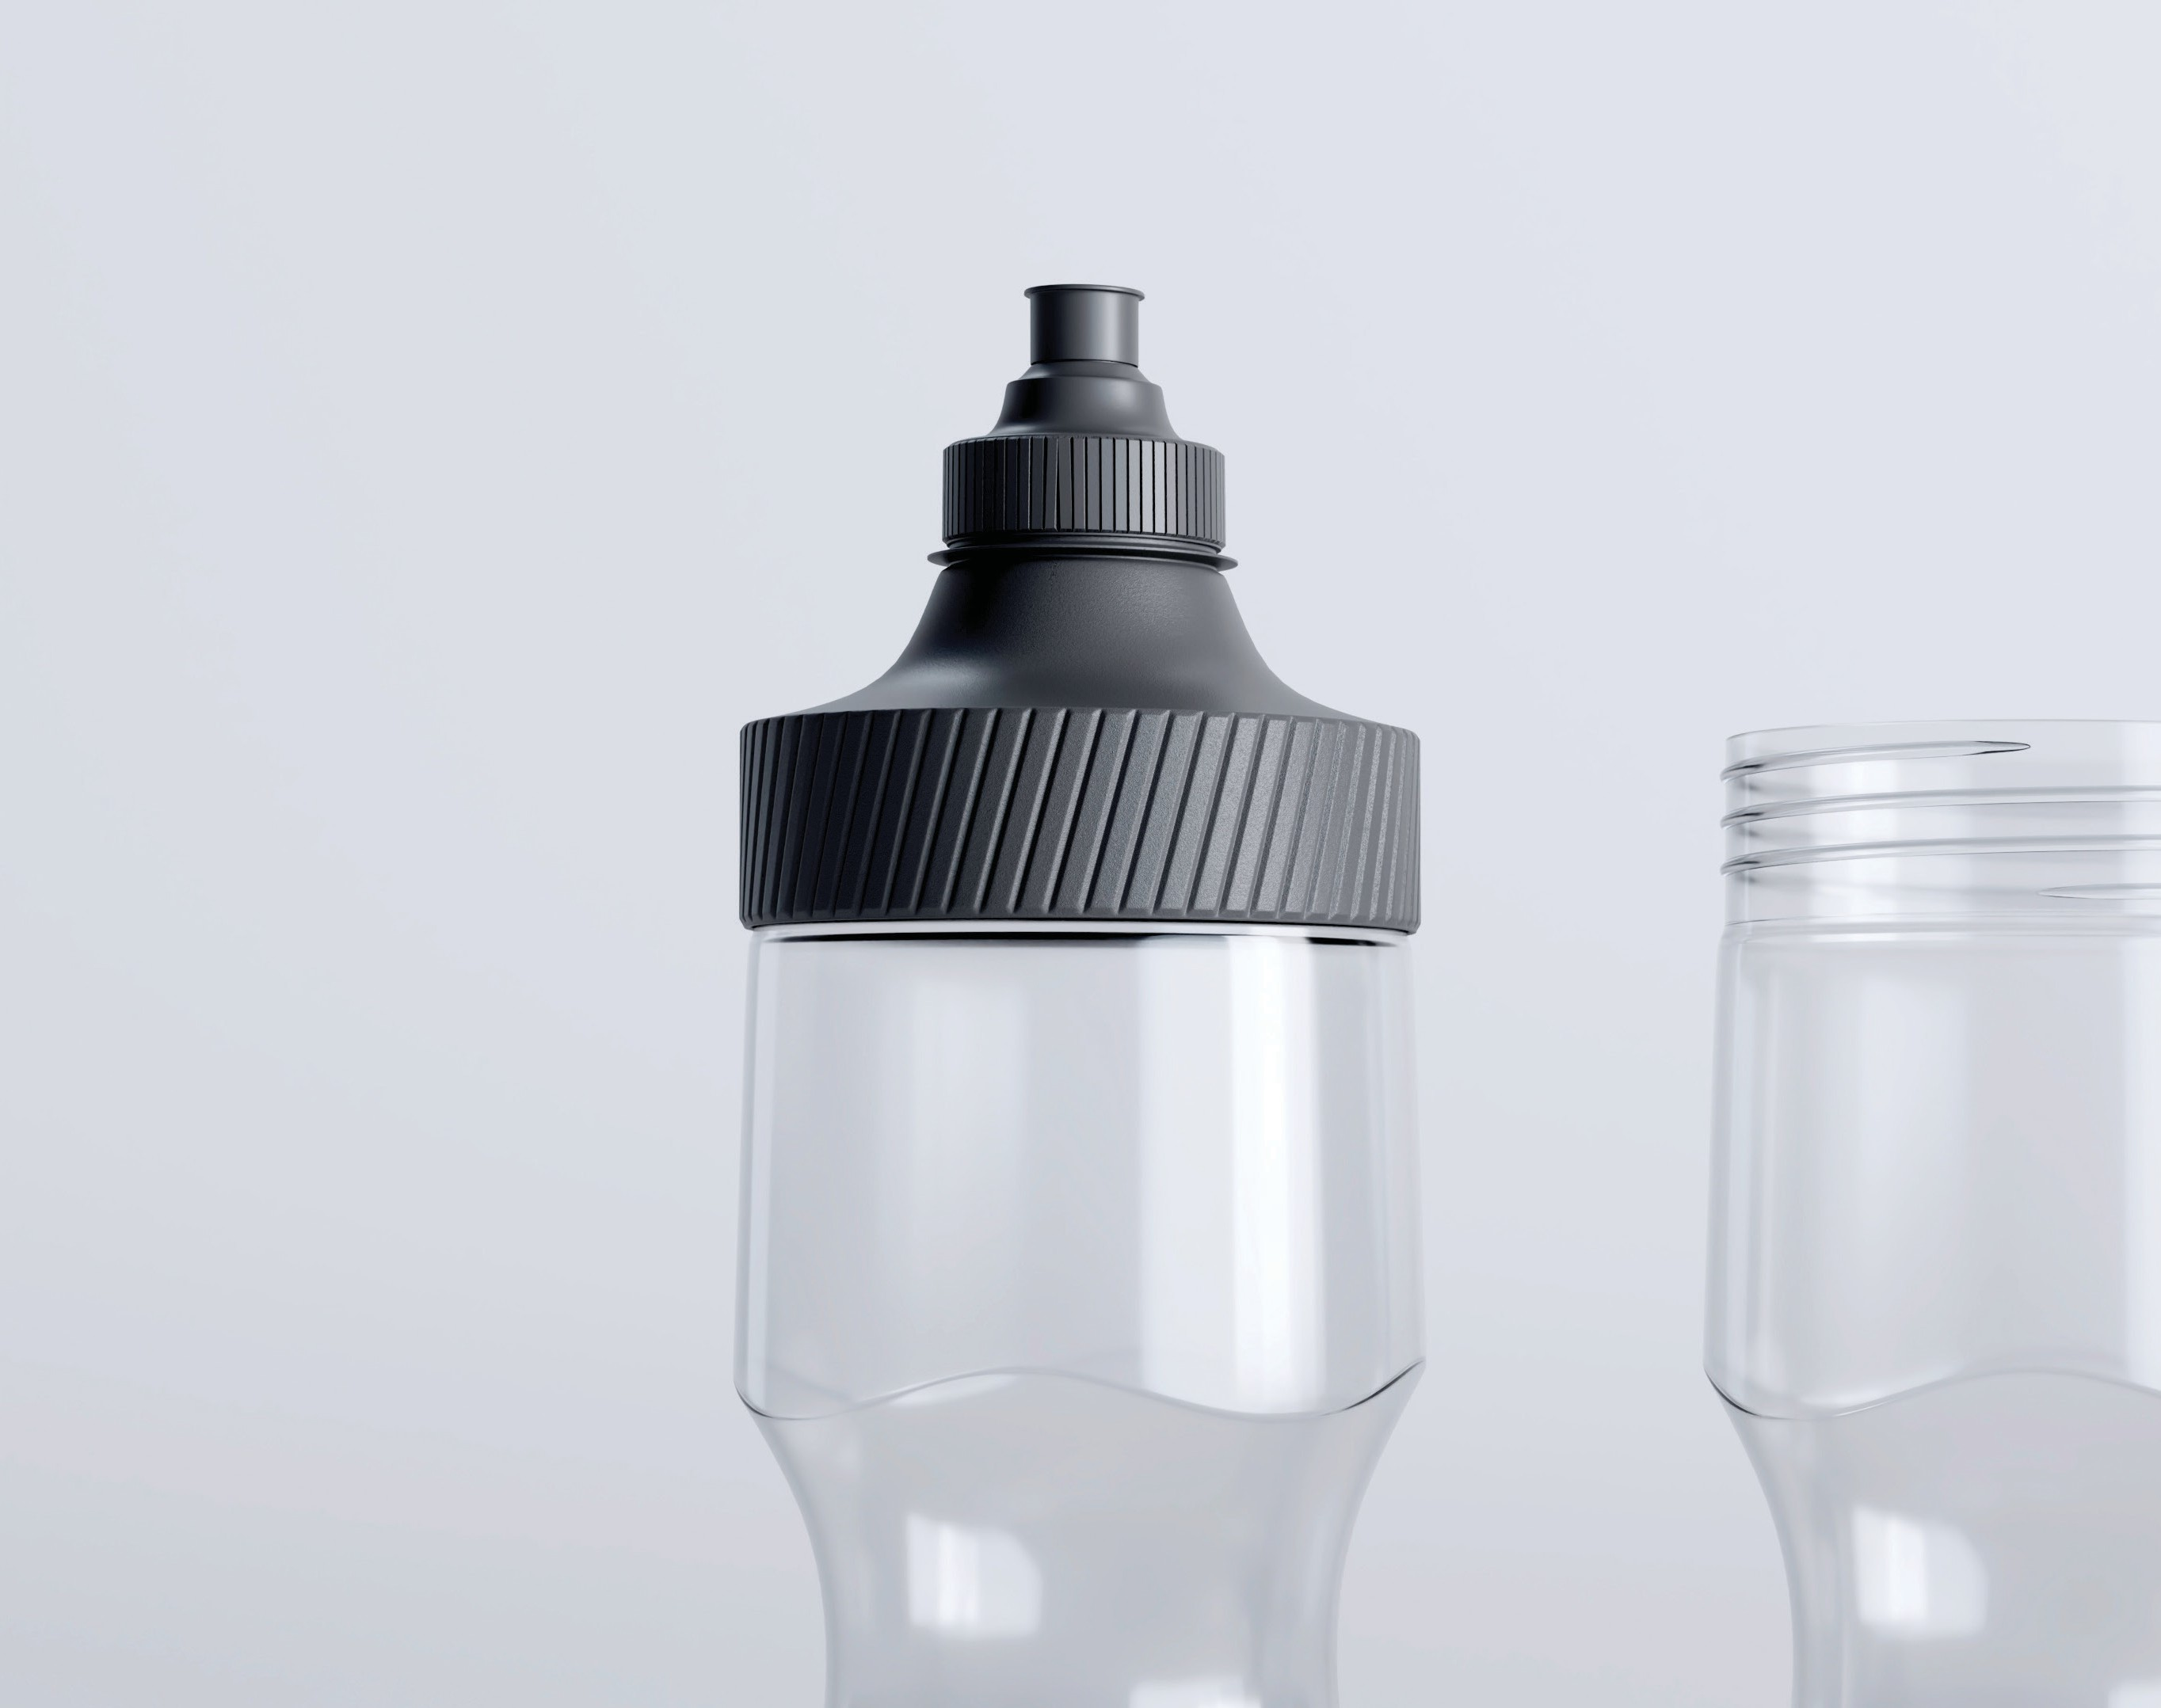
Research & Early Development
First Stage of Development
The first stage of development focused on understanding existing drink containers.
That realization forced me to step away from shapes and features and return to the original objective.
I studied sports bottles, travel mugs, tumblers, shaker bottles, and reusable cups. While many
were well-designed, I found myself recreating products that already existed. Every direction seemed familiar.
What problem am I actually trying to solve?
The answer became the project’s guiding philosophy:
Reuse. Reseal. Refresh.
Every design decision that followed was measured against those three principles.
2

Slide 4
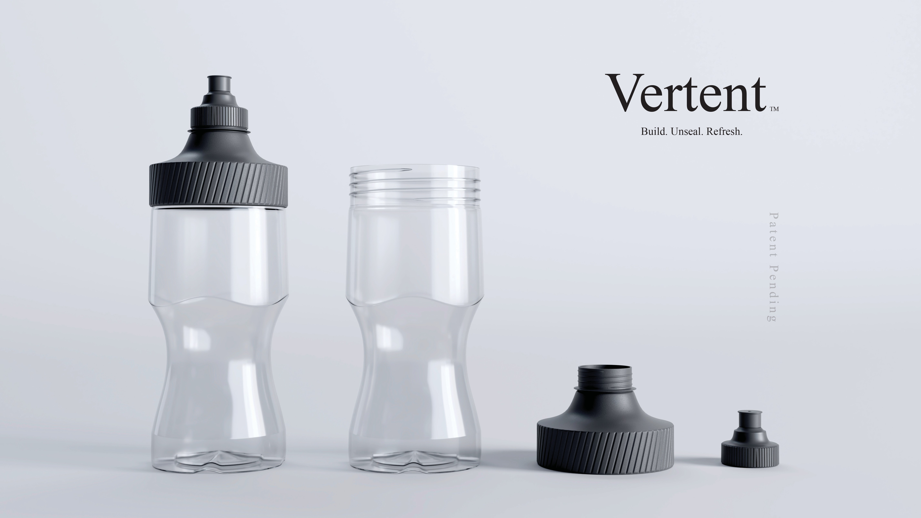
2b

Slide 5
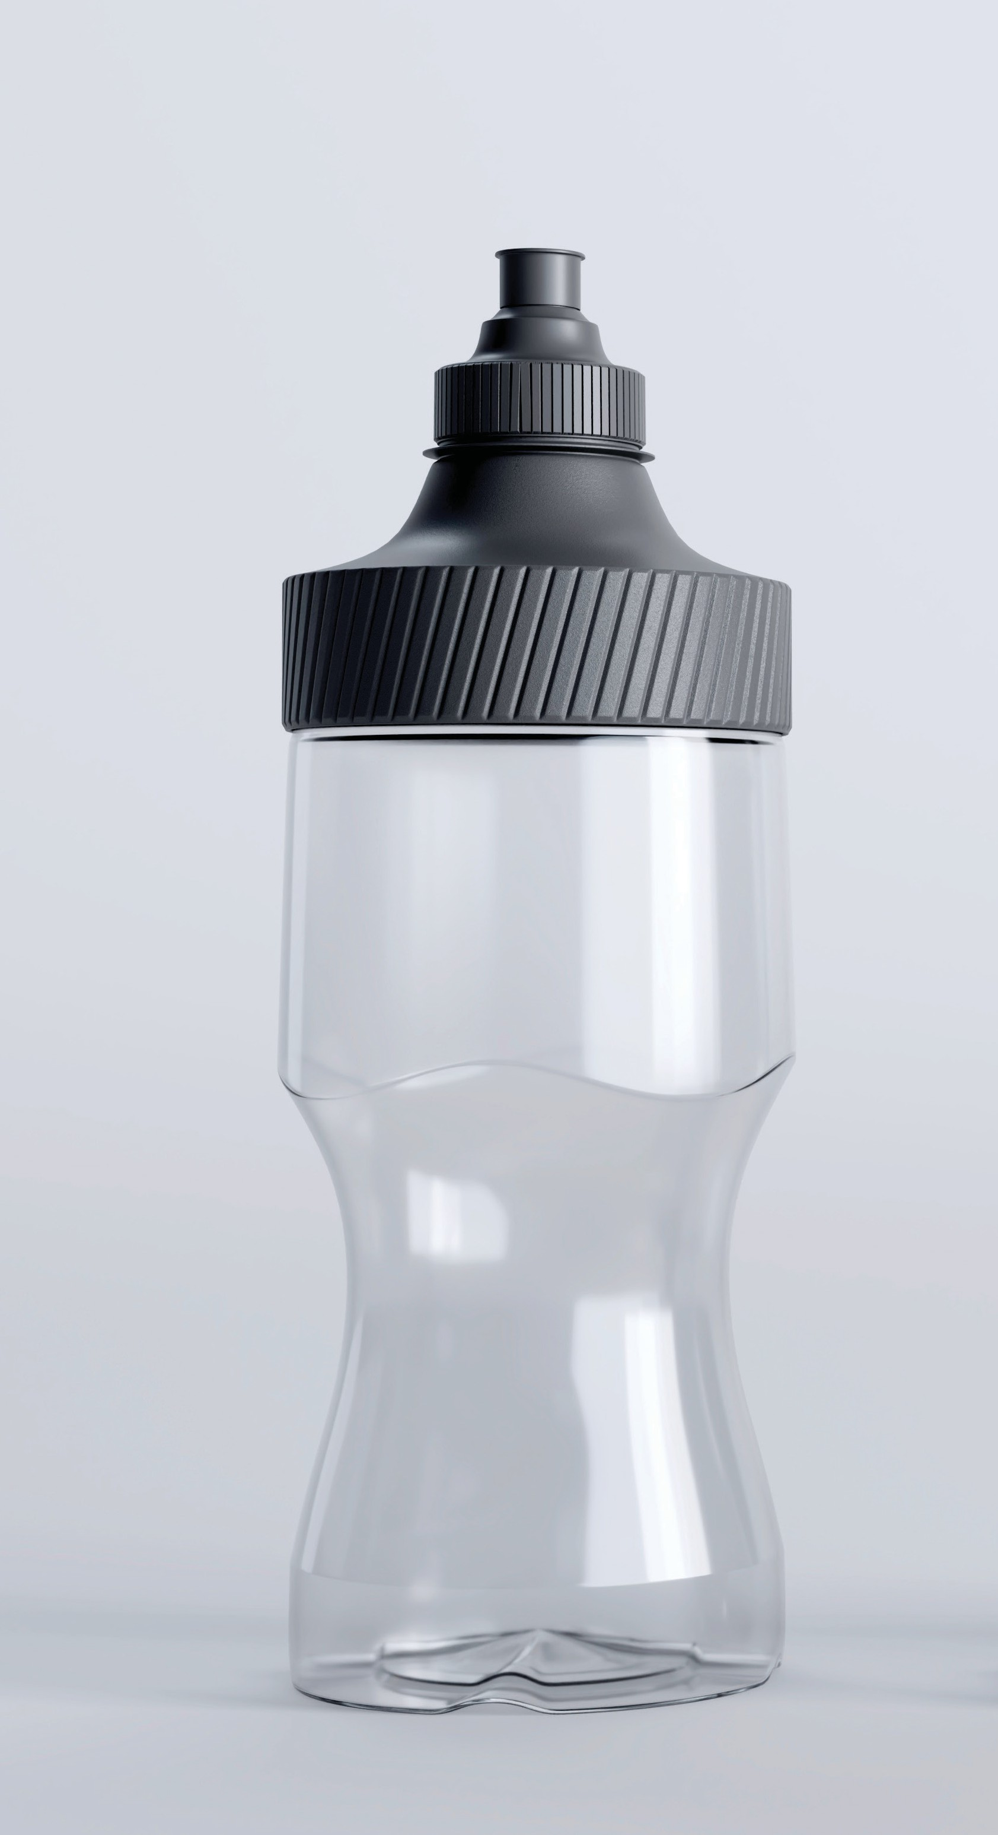
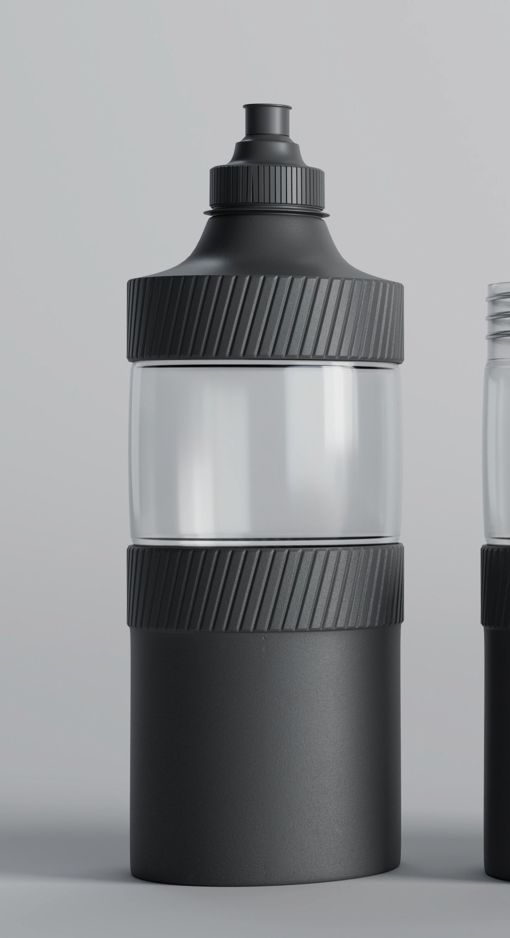
From Cup to System
Continued Development
As development continued, I realized the concept had the potential to become much more than a reusable fountain drink cup.
Answering those questions required rethinking nearly every component.
The lid and upper assembly had evolved into a strong solution, but the body itself still felt generic. It functioned well, yet lacked a clear design purpose.
Could it safely hold hot coffee?
Could it carry soup?
Could it mix protein shakes?
Could it be manufactured efficiently?
Could it survive everyday use?
Instead of decorating the form, I searched for a functional reason to change it.
3

Slide 6
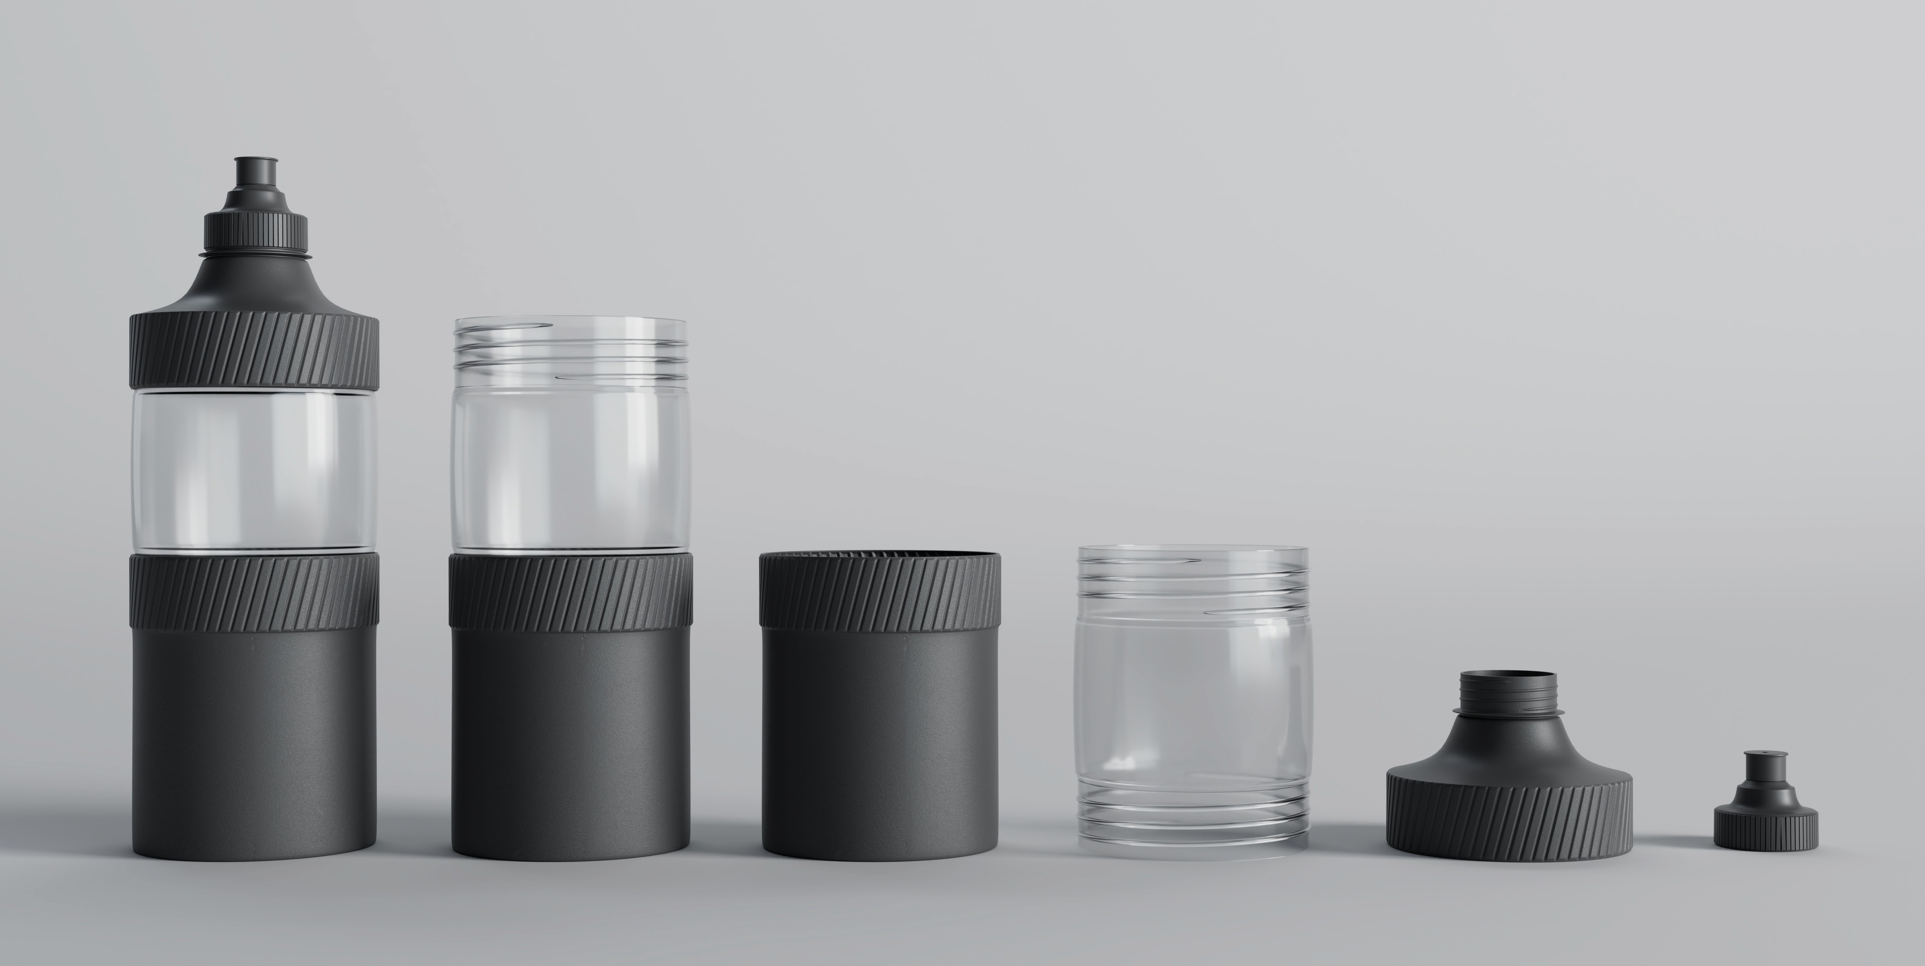
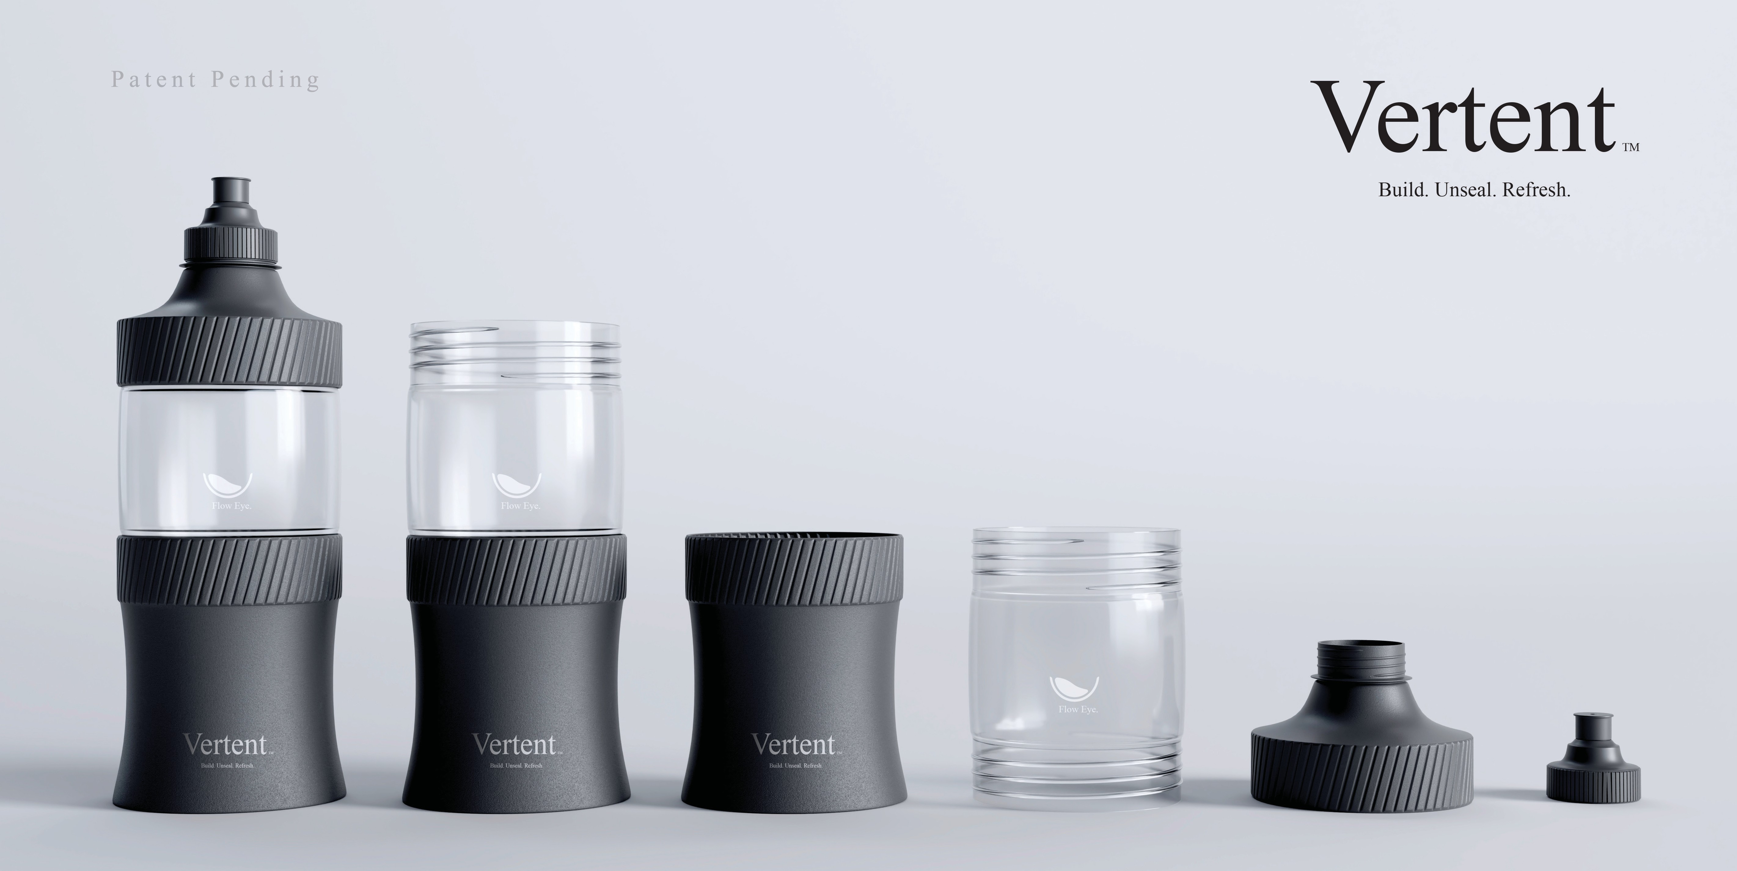
Discovering the Form
The base originally began as a straight cylindrical cup. It was practical, but uninspiring.
The new geometry suddenly made perfect sense.
The outward curve of the center section—later developed into the Flow Eye™—created a natural gripping point. The curved lower body allowed the bottle to nest comfortably in the palm, while the wider upper and lower edges gave users secure control during mixing and shaking.
To improve comfort, I experimented with an inverted profile inspired by the proportions of a traditional chalice. At first, the shape simply felt better in the hand, even though I couldn’t fully justify why.
That justification came later.
What had begun as an aesthetic choice became an ergonomic solution.
As I explored mixing powdered drinks and protein supplements, I realized the bottle would often be shaken vigorously.
That insight marked the birth of the Sports Series.
4

Slide 7
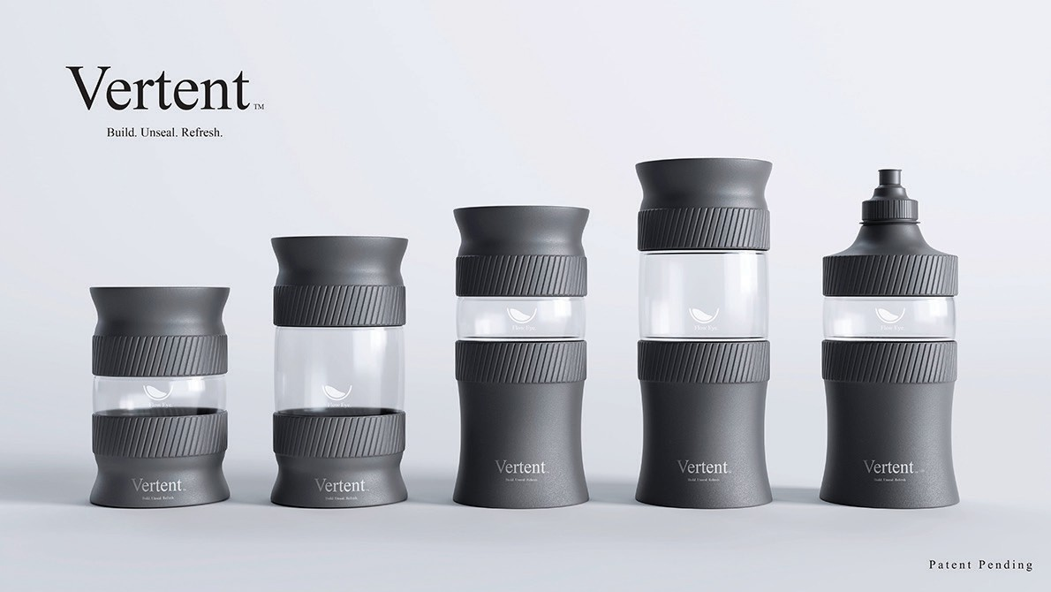
4b

Slide 8
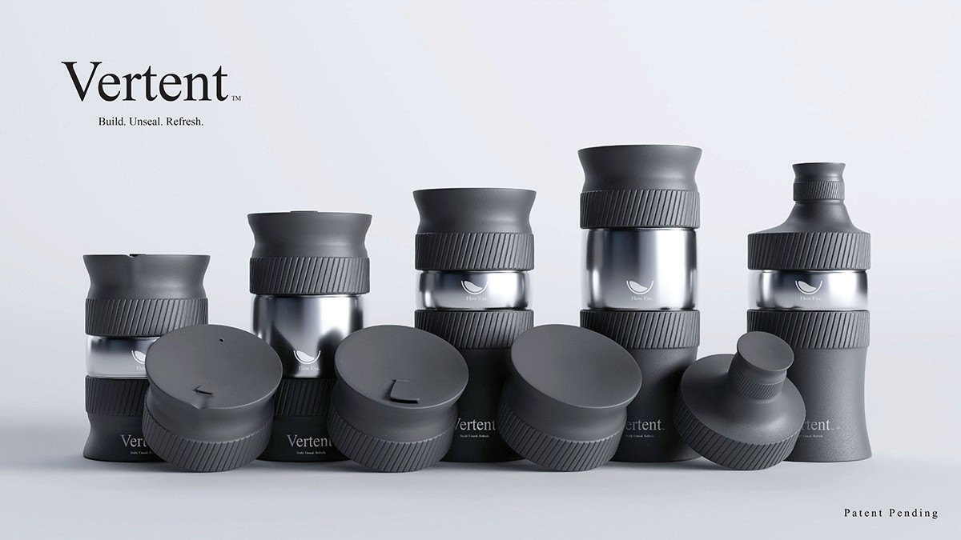
Expanding the Platform
Direction Of Designs
For a long time, the Sports Series represented the primary direction of the project.
At first, it seemed like a simple
material substitution.
Then I realized something more important.
Then another everyday experience changed the design once again.
Rather than choosing one concept over another, I already had the beginnings of an entire product family.
Passing coffee shops each morning, I began thinking about how the same system could better serve hot beverages.
Instead of competing designs, each configuration solved a different user need while sharing the same modular architecture.
A thermal version felt like the natural next step.
Replacing the transparent Flow Eye™ with a stainless-steel component improved durability while supporting a premium insulated configuration better suited for coffee, tea, and other hot drinks.
Reuse. Reseal. Refresh.
That realization transformed Vertent from a single reusable cup into a scalable design platform consisting of the Service Series, Sports Series, Sports Survival Series, and future product variations—all built around the same philosophy:
5

Slide 9
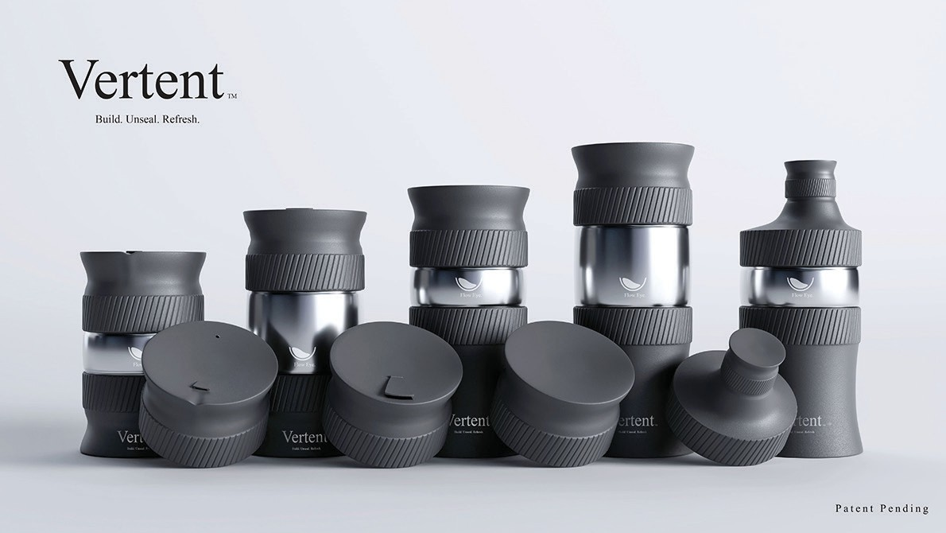
5b

Slide 10
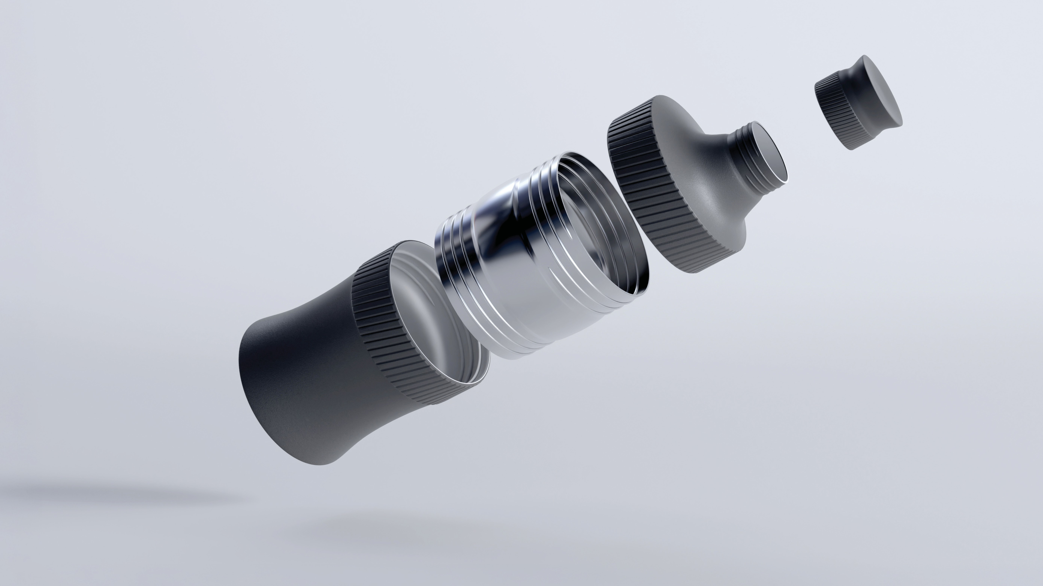
Component Design
Body
The contoured body provides an ergonomic grip while maintaining a modern silhouette. Its wide-mouth opening accommodates larger ingredients and simplifies cleaning.
The transparent construction allows users to see the contents while enhancing the premium appearance of the product.
Flow Eye™
Sports Cap / Standard Cap
Positioned between the body and the lid, the Flow Eye regulates beverage flow while creating a dedicated
modular connection point. Depending on the product series, this component
is manufactured from either durable transparent polymer or stainless steel.
Users can choose between a sports nozzle for active use or a traditional cap for everyday transportation and storage. Both sealing options integrate into the same modular system.
Body Top
The Body Top guides liquid flow to provide a smoother, more controlled drinking experience while securely connecting the upper and lower assemblies.
6

